Slide 1
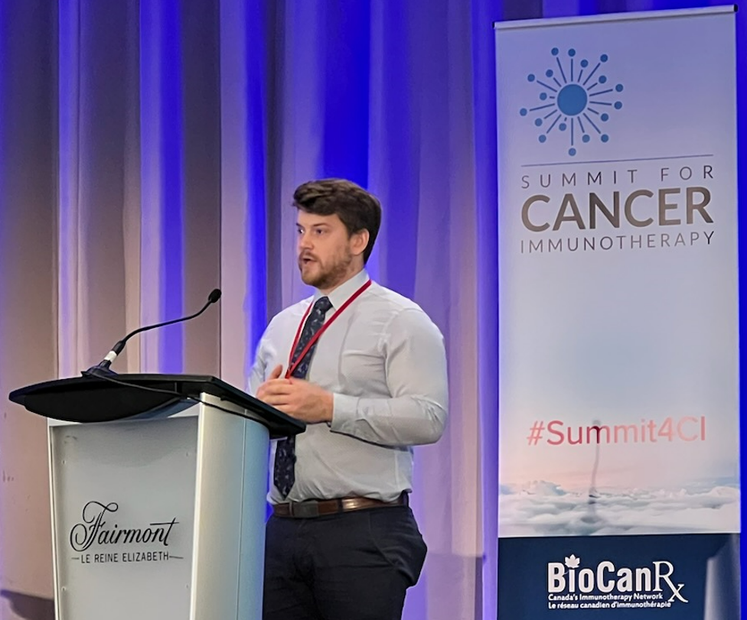
Congratulations to Brian Laight (MD-PhD candidate in Dr. Greer’s lab) for being recognized at the BioCanRx Summit for Cancer Immunotherapy in Ottawa for giving the best speed poster presentation entitled “Enhancing anti-cancer immunotherapy by disruption of the non-receptor tyrosine kinase Fes”

